Slide 1
WAVYNAVY
Hari Purnapatre
Karan Juneja
Sreevani B Patil

Slide 2
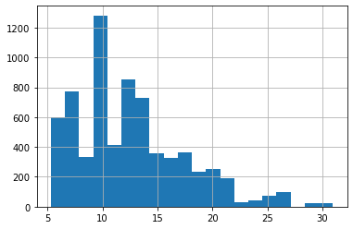
DATA EXPLORATION
Data Distribution i.e the distribution of test and train.
Checked the distribution of the target variables.
Null values
Counts
Unique Values

Slide 3
DATA CLEANING & PREPROCESSING
Convert target variable to log.
Converted object variable data type to numeric using encodings.
Removed highly correlated variables.

Slide 4
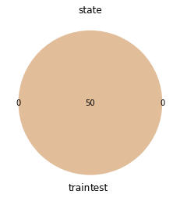
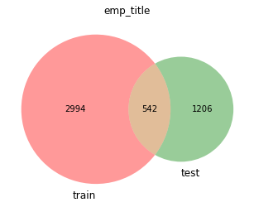
DATA VISUALISATION

Slide 5
FEATURE ENGINEERING
For feature engineering we converted some variables to one hot encoded variables.(helps with decision trees).
Created features using domain knowledge such as total credit, debt.
Removed Columns that have different distributions or values in test and train.

Slide 6
MODELING
Training set 0.80 and Validation set 0.20
Used Lightgbm a boosting model.
Used Kfold with 7 folds.
Averaged the predictions inside the folds.

Slide 7
HYPERPARAMETER TUNING
Didn’t do

Slide 8
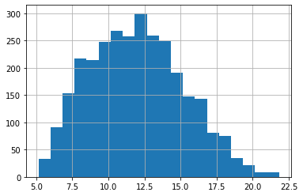
ACCURACY REPORT
Cross Validation Score : 0.2570
Validation Score : 0.2528
Public Score : 0.2406

Slide 9
CONCLUSION
Term is the most important feature in deciding the interest ratio.
The 2nd best feature is debt to income ratio.
Sometimes hyperparameter tuning isn’t necessary if you have good features.
Trees are one of the most robust models in working with small tabular data.

